Slide 1
Streamlining Medicaid Enterprise Systems Updates on the Medicaid Detailed Budget Table Process and Template
State Information Session
Medicaid Enterprise Systems (MES) Operations Team
March 25, 2026
For Public Release
Notes:
We will also have additional trainings on the recently approved templates

Slide 2
Objectives
This session provides an overview of the changes to the Medicaid Detailed Budget Table (MDBT) Requirements for Medicaid Enterprise System (MES) Submissions
Understand the changes to the MDBT submission process
Understand the roles and responsibilities in submitting MDBTs
Understand how the new MDBT Template is organized
Understand how to transition to the new MDBT template and process

Slide 3
Goals
Improve Timeliness from Submission to Decision
Improve Customer Service to States
Reduce friction for implementation of the new MDBT template

Slide 4
Current MDBT Challenges
Current Process
Every APD must have a Unified (Project + Consolidated) MDBT built on the last approved MDBT
Each submission is dependent on the one ahead of it, resulting in a First In, First Out (FIFO) clearance process
Benefit
High level of real-time financial accounting and reporting accuracy
Concerns
States must plan submissions in the order of priority based on CMS's ability to approve
Bottlenecks with out-of-sequence approvals
Adds additional steps to update any downstream MDBT if any of the APDs ahead of need revisions
Notes:
Consolidate MDBT refers to the compiled list of MDBTs for each project, with the total costs listed

Slide 5
Revisions to the MDBT Process
New Process
Every APD will be required to have a project-level MDBT only (i.e., no Unified MDBT is required)
Submissions are no longer dependent on FIFO (the one ahead of it)
Benefit
Allows out-of-sequence submissions and approvals for APDs
No rework for the Unified MDBTs
Improves the flexibility of submission order to CMS
State has access to the CMS-maintained Unified MDBT at all times

Slide 6
New Process
State
MES Submission
State Officer
Review
Clearance
Decision
Project Only MDBT
Approval Letters has the Project MDBT only
State
Post Approval Review of the Unified MDBT
Provides a Recommendation
CMS updates the Unified MDBT

Slide 7
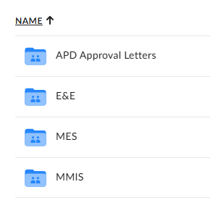
Roles and Responsibilities
MES State Officers
Share the state-specific MDBT Box folder with their states
States
Verify that the state POC has access to the folders
Validate the current, full MDBT funding for E&E and MMIS and share with MES SO
MDBTs do not need to be submitted with an APD
Transition to the new MDBT format can occur at the same time
Notes:
Full Project funding history not based on the current MDBT (which may remove previously approved funding)

Slide 8
Roles and Responsibilities (Submission)
States
APD submission will include the project(s) MDBT only
No need to submit the Unified MDBT
MES State Officers (SOs)
MDBT review will be project-focused, reviewing both in-state and private contractor costs
Notes:
We will provide language for the monthly reminder; most attention will be new MDBT post when we split the line items yet

Slide 9
Roles and Responsibilities (Post-approval)
Medicaid Enterprise Systems Operations Team
MES Ops will update and maintain the Unified MDBT
MES State Officers
Review the CMS-maintained Unified MDBT
Monthly, will send an email to their states to review their Unified MDBT
States
Review the CMS-maintained Unified MDBT
Report any concerns, errors, or questions to your MES State Officers
Notes:
Instructions on how to share the folders has been previously been shared

Slide 10
New MDBT Template
Required for all submissions starting July 1, 2026

Slide 11
New MDBT Release - Version 1.09
Fixes
Improves backwards compatibility with earlier versions of Excel
Corrects total calculations on portions of the MES Master tab
Removes an extraneous table in the MES Master tab
Special Note for Early Adopters
If you have already transitioned to Version 1.08 of the MDBT, you can copy the project tabs to the new version
For technical assistance, contact your MES State Officer

Slide 12
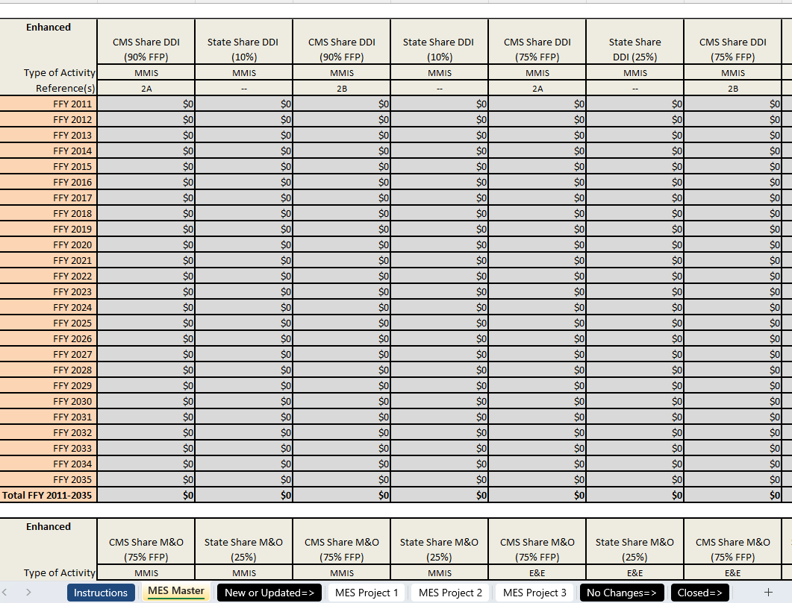
MES Master Tab MDBT Template
Sums all the funding for all projects together
Covers Federal Fiscal Years 2011 - 2035
Enhanced
Non-enhanced
Totals

Slide 13
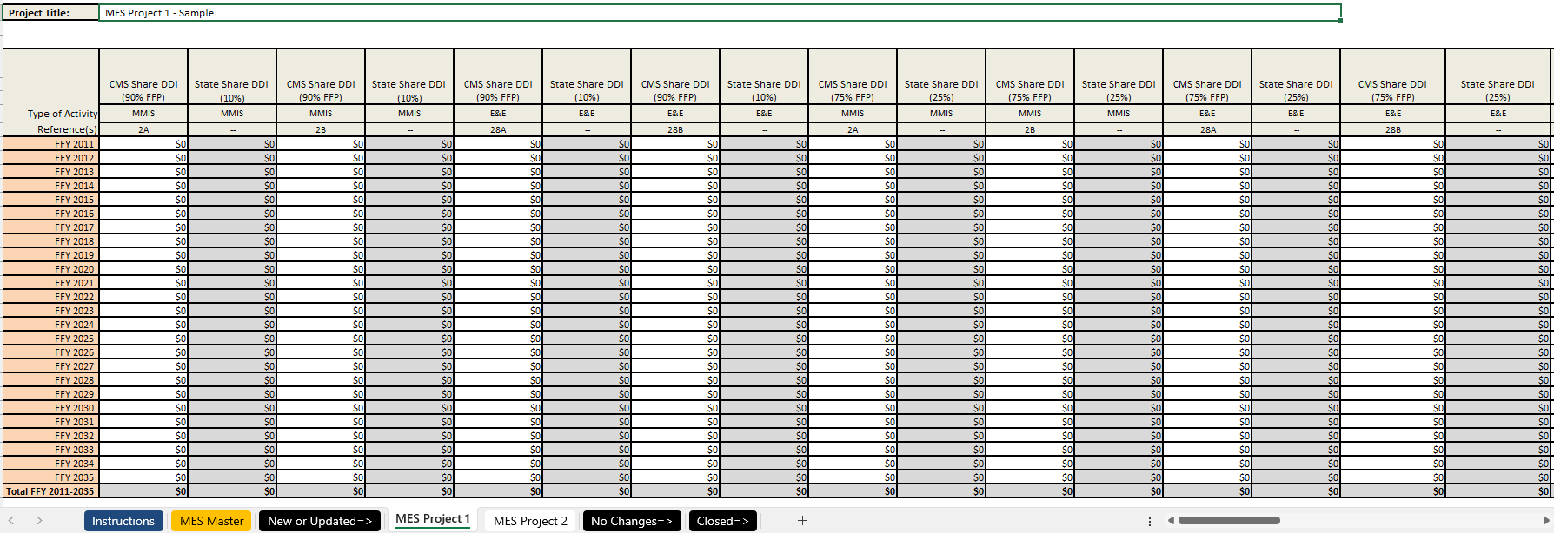
Project Specific MDBT Template
Project Title
Enhanced
Non-enhanced
CHIP
Totals
Make sure the tab name is the project name

Slide 14
The Project Specific MDBT
 | Old MDBT | New MDBT
MMIS and E&E Costs | Separate MDBTs | Unified MDBT
MBES/MACFin Line items | Unified In-House and Private Contractor Costs Categories (e.g., 5AB) | Separate In-House and Private Contractor Cost Categories (e.g., 5A and 5B)
Line 49* | Not included | Included**
CHIP Funding* | Not included | Included**
Approval Letter | Includes Project and Consolidated MDBTs | Project-specific MDBTs Only
*Will not be approved in the MES Approval Letters
**Not included in the MES Master tab

Slide 15
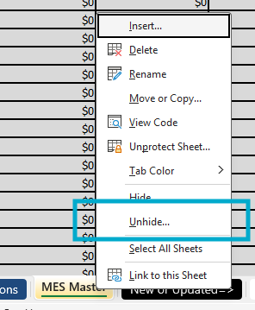
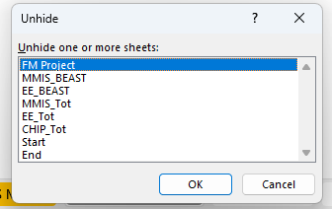
MES Master MDBT
In addition to the MES Master tab and project tabs, there are "hidden" tabs
Right click on tabs
Click "Unhide"
Select one or many sheets to unhide

Slide 16
The Hidden Tabs MDBT
Tab Name | Use
FM Project | Allows the user to filter to a specific project MDBT, Combining In-House and Private Contractor Costs
MMIS_BEAST | Total MMIS funding for all projects, combining all In-House and Private Contractor Costs (e.g., 2A+2B)
MMIS_Tot | Total MMIS funding for all projects, separate In-House and Private Contractor Costs(e.g., 2A and 2B)
EE_BEAST | Total E&E Funding for all projects, combining all In-House and Private Contractor Costs (e.g., 28A+28B)
EE_Tot | Total E&E funding for all projects, separate In-House and Private Contractor Costs (e.g., 28A and 28B)
CHIP_Tot | Total CHIP funding for all projects

Slide 17
Transitioning to the new MDBT format
States will complete a one-time transition from the separate MMIS and E&E MDBT to the new MES MDBT template
Once the transition is complete, do not submit the previous MDBT format to CMS
Keep project names intact, but if there is a need to change the project name
Discuss with your MES State Officer
Change the project tab name to the new name
Add "Prev [Old Project Name]"
Once the new MDBT transition has been validated, only project-specific MDBTs will be required
Coordinate with your MES State Officer and your internal stakeholders on when to complete the transition

Slide 18
One Time Transition to the new MDBT Format
✓ DO | ✗ DON'T
Compile a complete record of approved MMIS and E&E funding | Send partial MDBTs with incomplete FFY data
Use existing Project Names ONLY for tab names | Add "APD," "MMIS," "E&E" or dates to project tab names
Include Title XIX and XXI funding only | Add custom elements to the MDBT (e.g., multi-OPDIV allocations).
Verify FFP values are accurate | Worry about small rounding difference in the state share (some states modified the MBDT so the state share formulas are no longer accurate)
Input previously approved funding in the "in-house" cost (e.g., 5A) | Retroactively split approved funding prior to FFY 2026
Use whole numbers only for funding amounts | Use cents for funding amounts
Notes:
Will need at least one E&E tab, CE tab will be separate and total E&E project costs will be included in the hidden E&E tabs

Slide 19
State Demo of New MDBT Transition
Wisconsin, Division of Medicaid Services
Carrie Kahn
Jeffrey Blankenheim

Slide 20
New MDBT Process with the new MDBT
Post Transition
States are encouraged to maintain their own copy of their Unified MDBT
States will only send project-specific MDBTs with their submissions
MES State Officers and States
Continue to work together to manage submission volume
Non-sequential APD approvals will give you more flexibility to plan a flow of submissions
Notes:
Once the transition occurs, should make the transition to the new MDBT more focused on the projects while CMS manages the project consolidated

Slide 21
Key Takeaways and Upcoming Dates
Post rollout to the States Key Changes:
States must provide full MDBTs for MMIS and E&E funding (old or new format)
State APD submissions will only include project level MDBTs
Approval Letters will only have project level MDBTs
State Officers will need to work closely with states to ensure timely validation of consolidated MDBT data
Important Dates
March 25, 2026: Project MDBT transition begins; requires finalized MDBT for MMIS and E&E
July 1, 2026: New MDBT format will be required
Notes:
We can start the validation anytime. Don't need to wait to submit an APD for us to validate the MDBT.

Slide 22
Contact Information
CDR Jerome Lee, USPHS Centers for Medicare & Medicaid Services | Jerome.Lee@cms.hhs.gov
Debbie Simon Centers for Medicare & Medicaid Services | Debbie.Simon@cms.hhs.gov
Alejandra Johnson Centers for Medicare & Medicaid Services | Alejandra.Johnson@cms.hhs.gov
Carrie Kahn Wisconsin Division of Medicaid Services | Carrie.Kahn@dhs.wisconsin.gov
Jeff Blankenheim Wisconsin Division of Medicaid Services | Jeffrey.Blankenheim@dhs.wisconsin.gov

Slide 23
Resources
Streamlining Medicaid Enterprise Systems Templates
GitHub | CMS MES Certification Repository

Slide 24

Questions

